Slide 1
Customer Segmentation
By: Goh Rui Zhuo (2222329)

Slide 2
Objectives
Problem Statement After covid 19, sales has been sale, mall has been losing sale and wants to find ways to improve Cluster the different customers into different group Find out the specifics of each different cluster groups
Dataset includes: 200 Rows x 5 Columns 3 numerical columns, and 1 categorical columns
General Info No anomaly dtype in the dataset Dataset is clean with no missing values and therefore additional exploratory data analysis can be done No anomaly was observed where in the numerical column

Slide 3
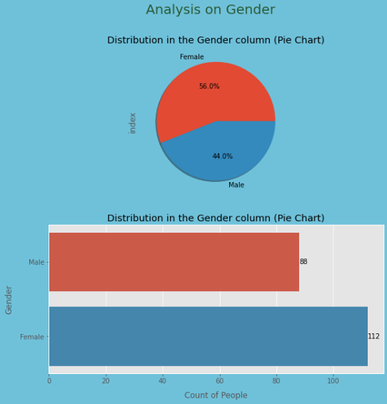
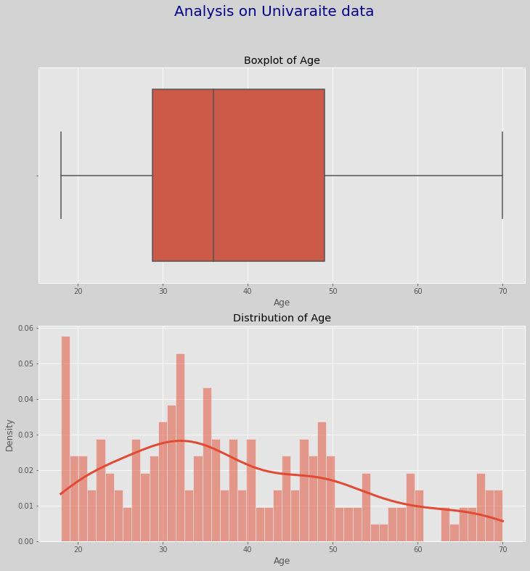
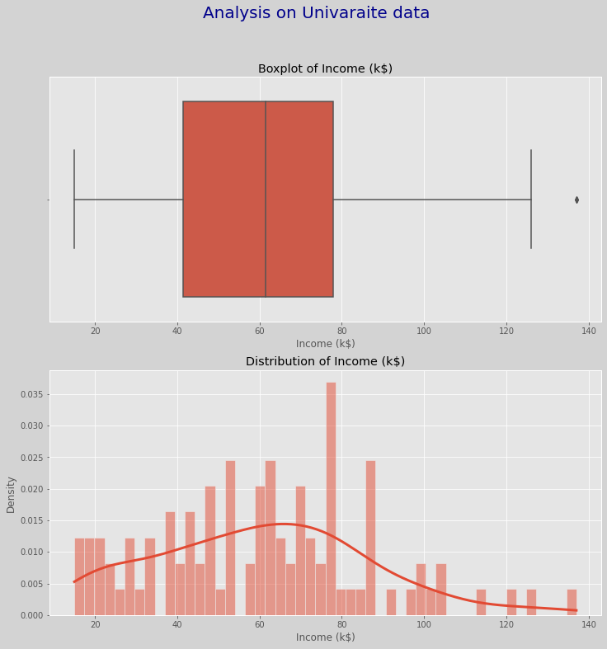
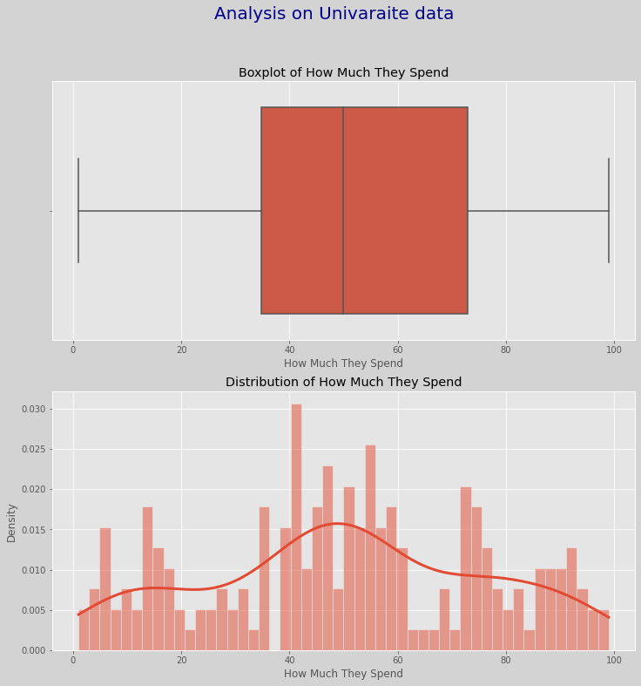
Exploratory data analysis (Part 1)

Slide 4
Exploratory data analysis (Part 2)
Categorical Data For Gender, we do see that the data contains a higher percentage of females as compared to males. From the countplot, we can see that 'male' is reported 88 times and 'female' is reported 112 times in the dataset.
Numerical Data For Age, there are no outliers. In terms of distribution, Age is positively skewed with the median at around 35 years old. From the histogram, the same result with a positively skewed data. For Income, there is an outlier. In terms of distribution, Income is negatively skewed with the median at around 60,000 over the years. From the histogram, the same result with a negatively skewed data. For How Much They Spend, there are no outliers. In terms of distribution, How Much They Spend is positively skewed with the median at around $50 tons over the years. From the histogram, the same result is shown

Slide 5
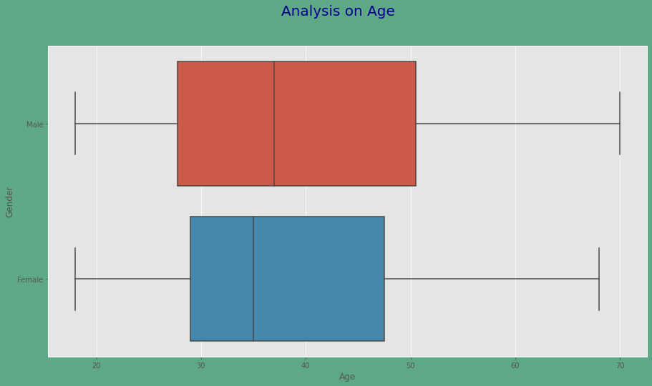
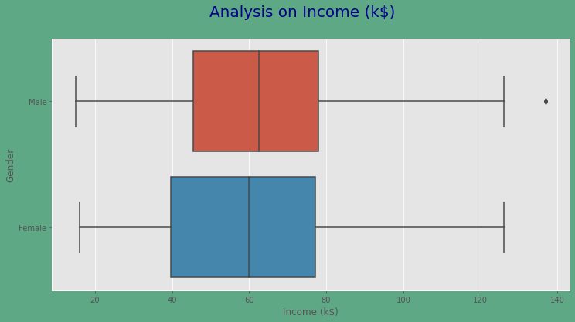
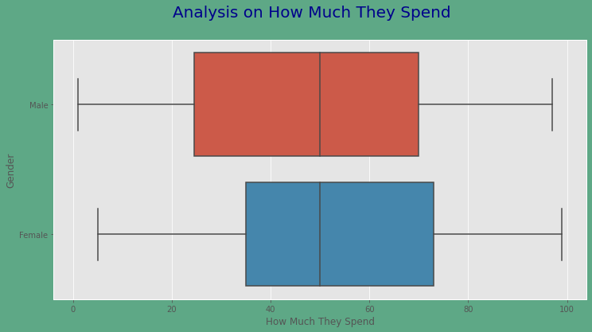
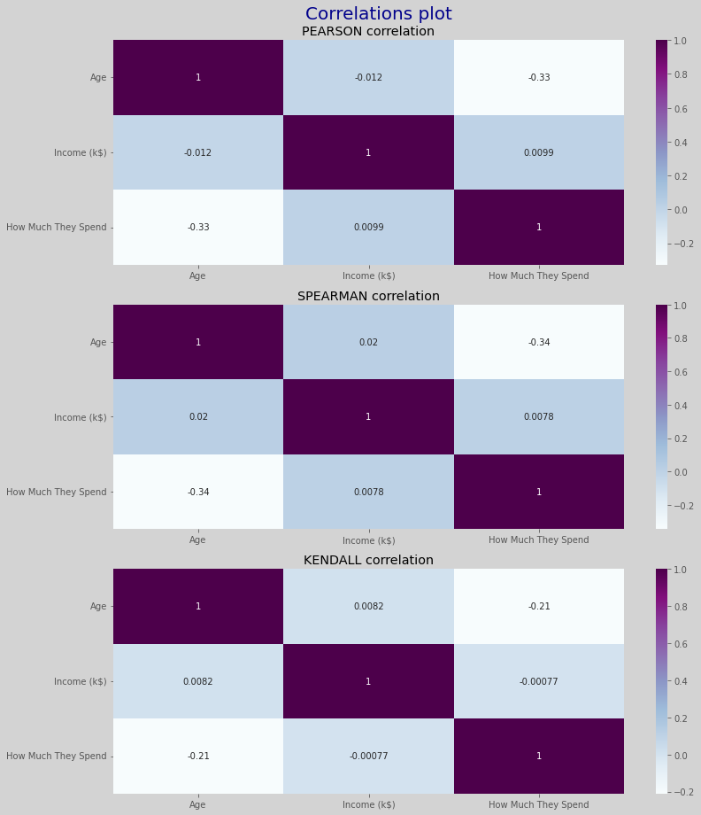
Exploratory data analysis (Part 2)

Slide 6
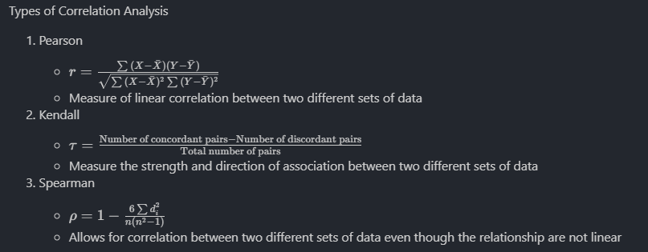
Exploratory data analysis (part 2)
Analysis on Numerical Data by Gender For Age, male has a wider interquartile range as compared to female, including a higher median as compared to female. For Income, male has a smaller interquartile range as compared to female, but a higher median as compared to female. For How Much They Spend, male has a wider interquartile range as compared to female, including a higher median as compared to female.
Correlation Analysis Pearson, Spearman and Kendall was used There is a weak relationship between age and how much they spend, however, since we want to perform clustering, the data is not affected by collinearity, we can leave it as it is. No significant correlation for others.

Slide 7
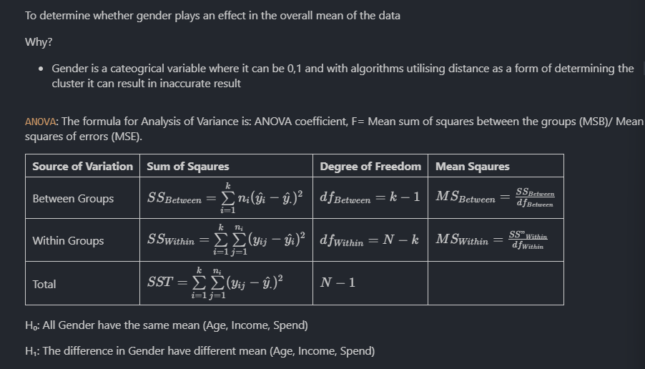
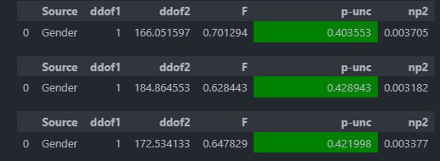
Exploratory data analysis (Part 3)
ANOVA statistic test on Gender column With P-Value all above 0.05, hence we cannot reject the null hypothesis and therefore it shows us that all genders have equal mean in different columns.male Hence we can remove gender from the dataframe
ANOVA Statistic Test

Slide 8
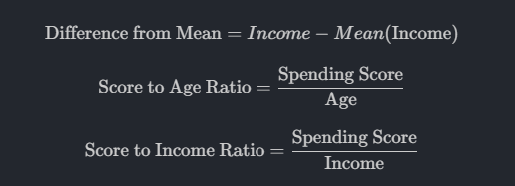
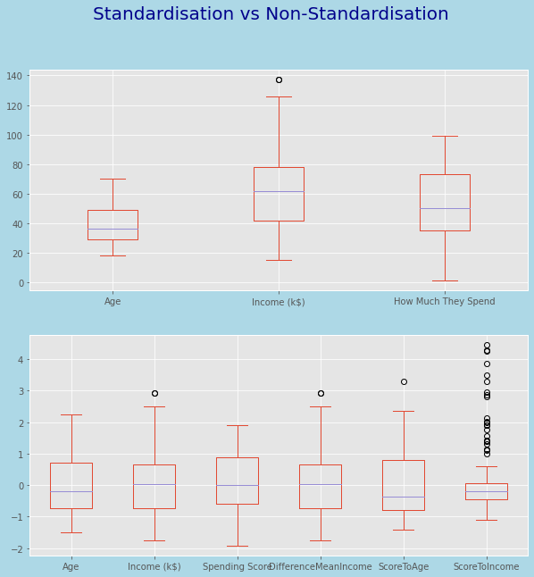
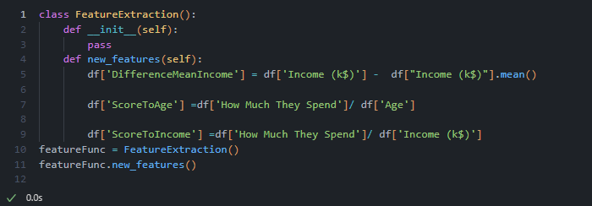
Feature engineering
Feature Extraction Difference from Mean Income Score to Age Ratio Score to Income Ratio
Standardisation and Feature Selection Customer ID column was dropped Standardisation was used Standard Scaler was used to standardise the data here

Slide 9
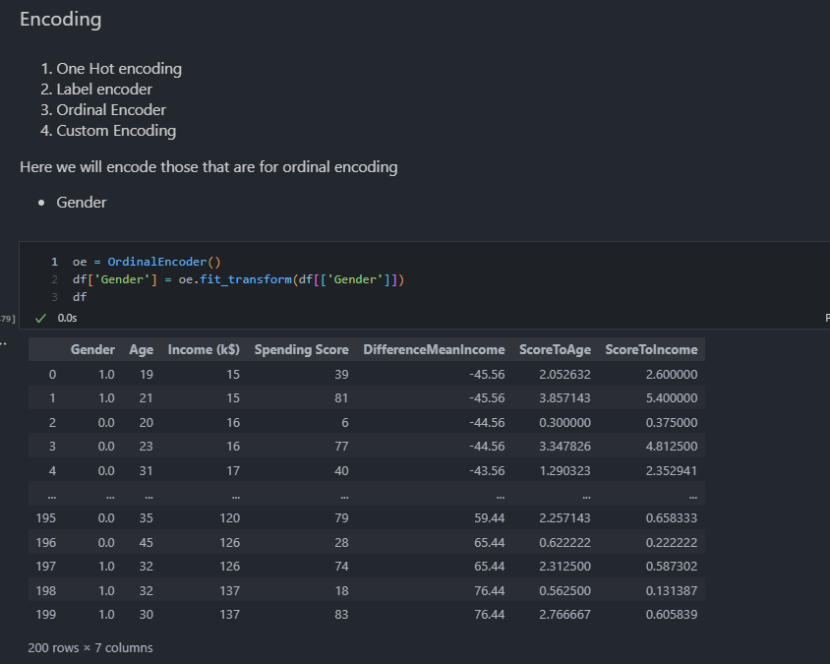
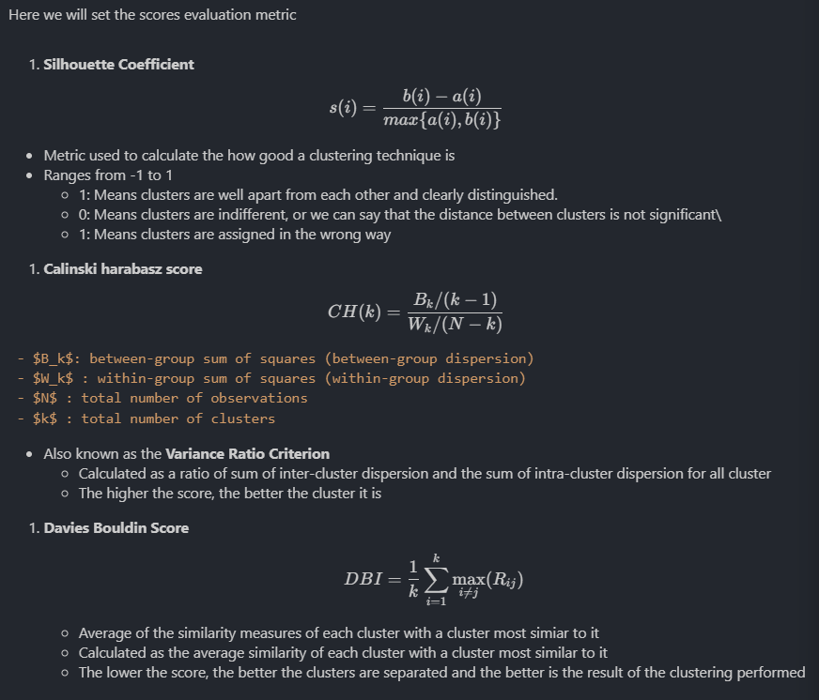
Data preprocessing
Preparing and Encoding Original df was prepared for comparison in later parts Data that are categorical was encoded Gender was done with ordinal encoding
Setting the evaluation metric Silhouette Coefficient Calinski Harabasz score Davies Bouldin Score

Slide 10
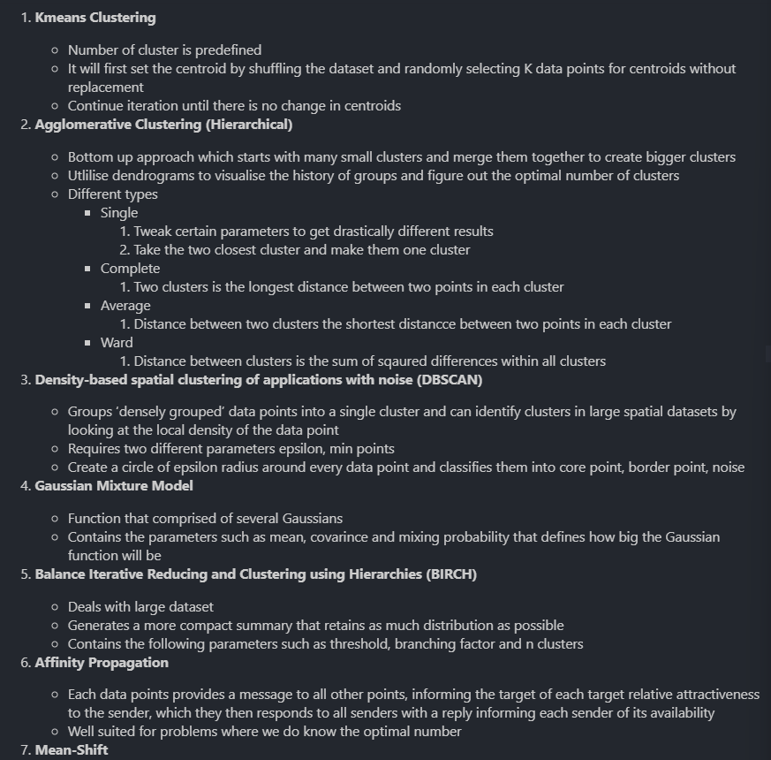
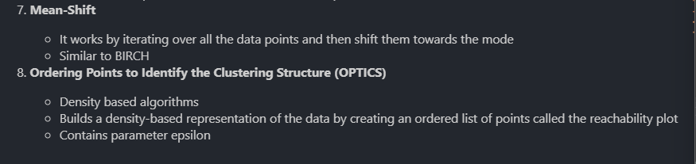
BASELIne model
Model Selection K Means Clustering Agglomerative Clustering Density Based spatial clustering of application with noise Gaussian Mixture Model Balance Iterative Reducing and Clustering using Hierarchies

Slide 11
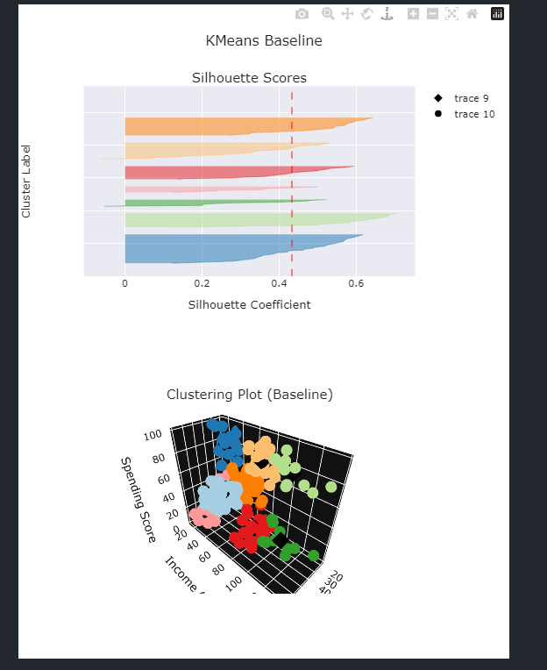
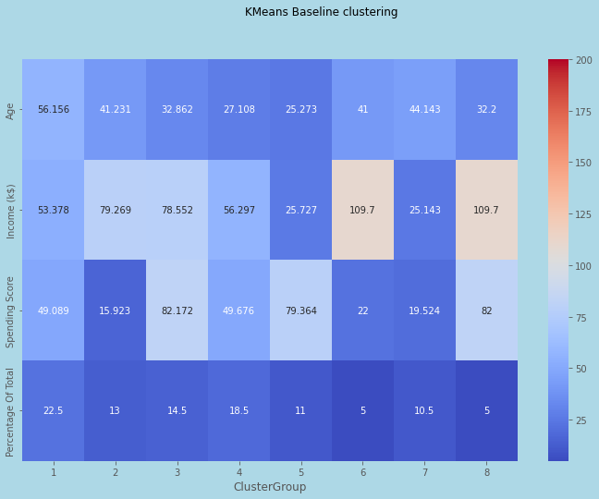
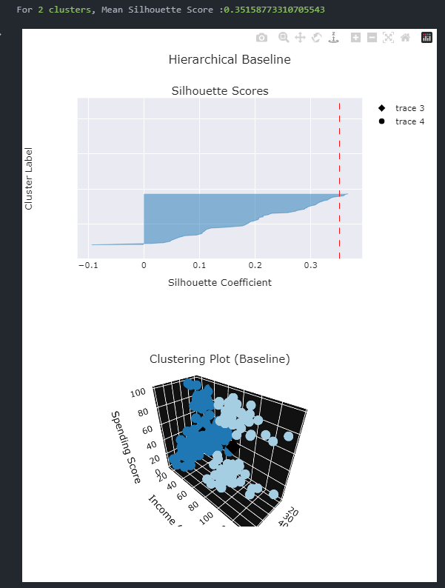
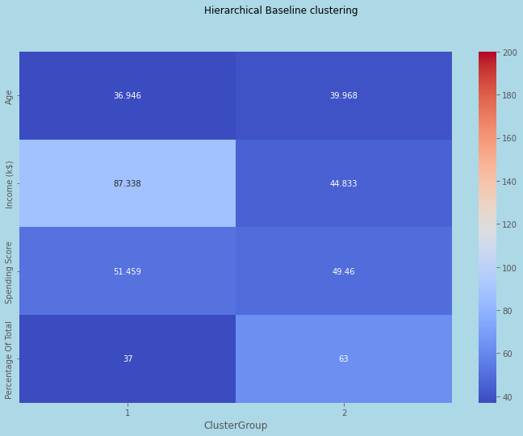
BASELIne model
K Means Clustering Silhouette score is 0.43 Calinski Harabasz score is 100.4 Davies Bouldin Score is 0.816 Cluster group 19 has the highest percentage at 19% Cluster group 7 and 8 are the smallest Cluster formed pretty well defined
Agglomerative Clustering Silhouette score is 0.351588 Calinski Harabasz score is 120.74 Davies Bouldin Score is 1.19 Cluster group 2 has the higher percentage at 63% Cluster formed pretty well defined

Slide 12
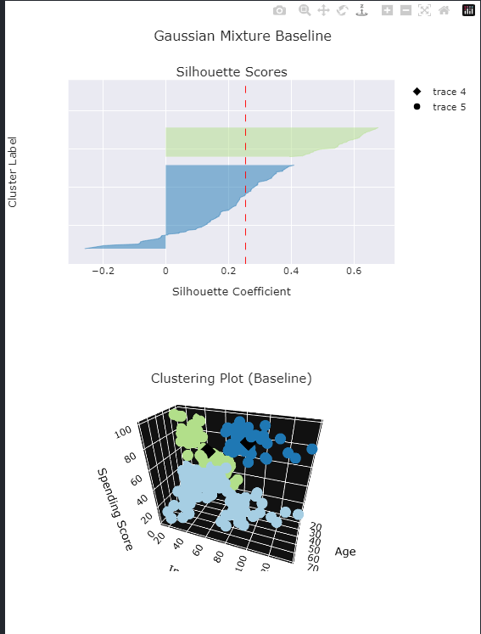
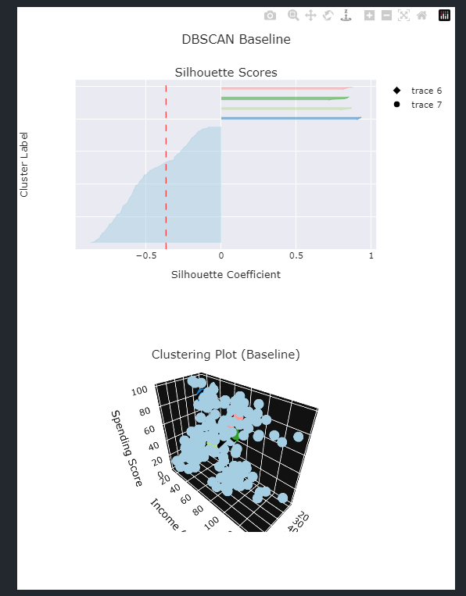
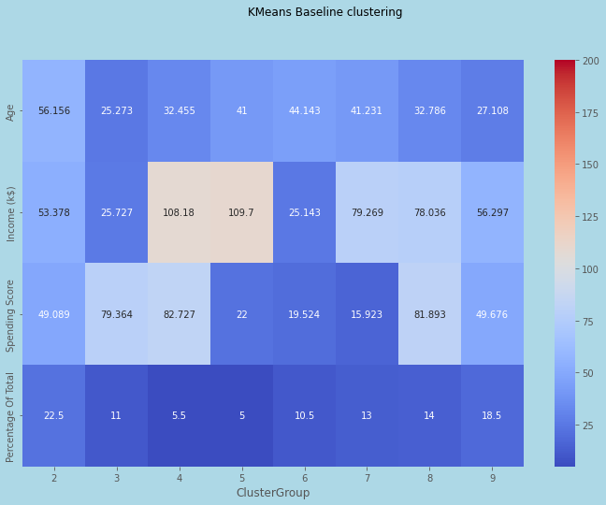
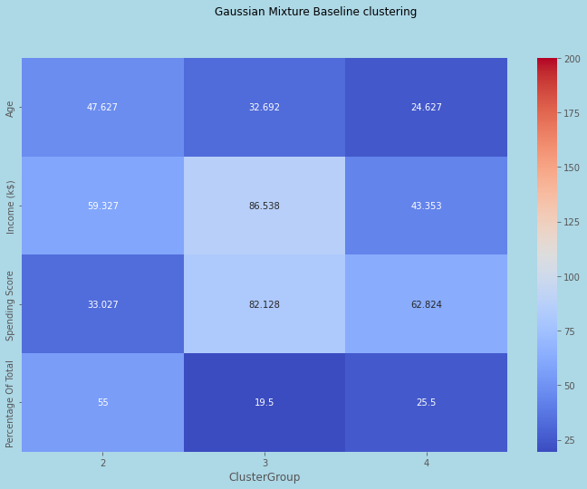
BASELIne model
DBSCAN Silhouette score is -0.368 Calinski Harabasz score is 3.87 Davies Bouldin Score is 2.86 Cluster group 1 has the higher percentage at 89.5% and Cluster formed not well defined
Gaussian Mixture Model Silhouette score is 0.254 Calinski Harabasz score is 69.0 Davies Bouldin Score is 1.29 Cluster group 1 has the higher percentage at 54.5%, and split by the three different features

Slide 13
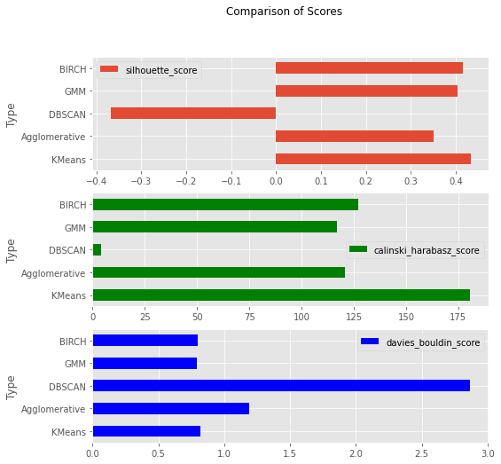
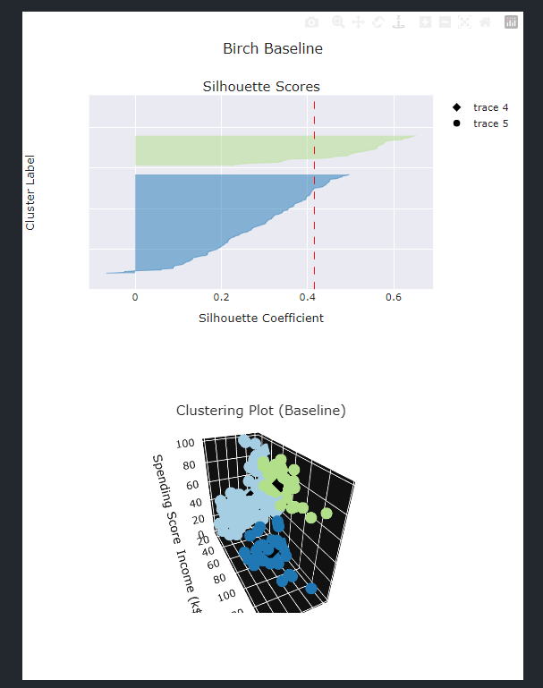
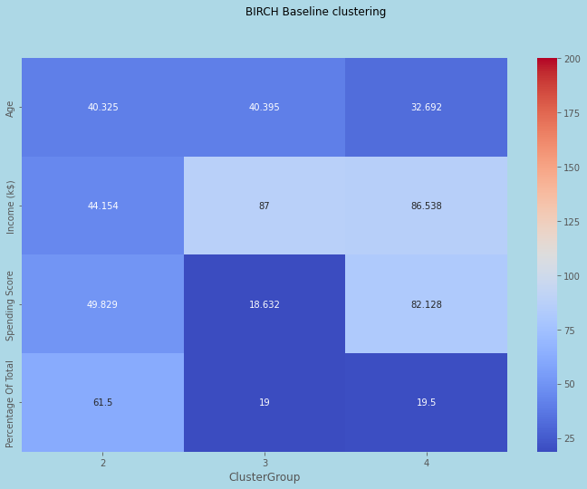
BASELIne model
BIRCH Silhouette score is 0.416 Calinski Harabasz score is 127,1 Davies Bouldin Score is 0.7995 Cluster group 1 has the higher percentage at 61.5%, and split by the three different features Cluster formed well defined
Overall, we can see that in terms of silhouette, kmeans is the best , calinski harabasz score, DBSCAN is the best and davies bouldin score, DBSCAN is also the best

Slide 14
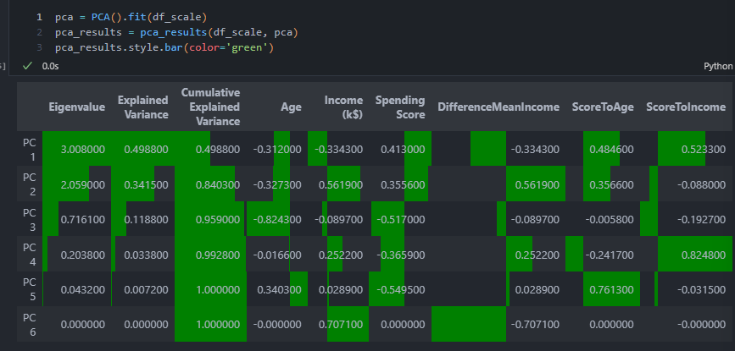
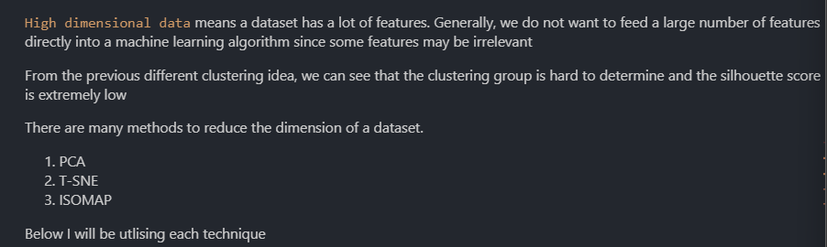
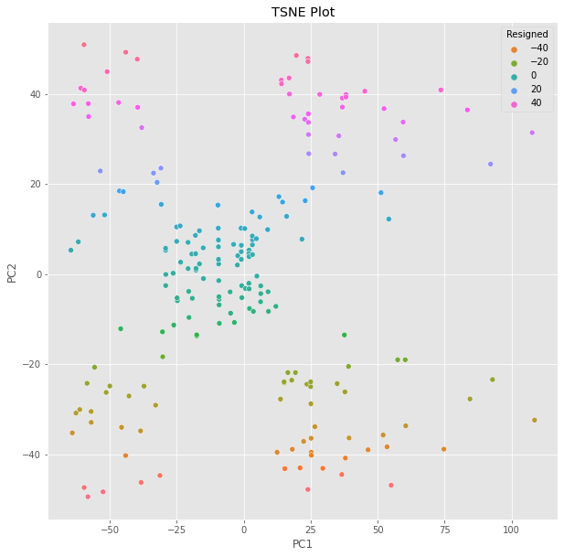
Dimensionality reduction
As the dataset contains 6 columns, we need to use dimensionality reduction in order to effectively visualise our clusters
PCA It finds a subspace that most preserves the data variance, with the subspace defined by the dominant eigenvectors of the data covariance matrix First 2 PC to be extracted

Slide 15
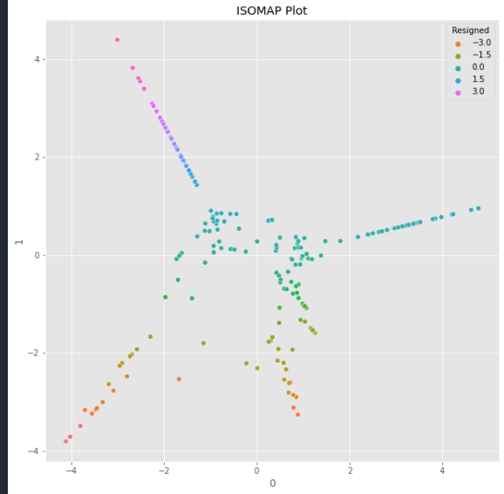
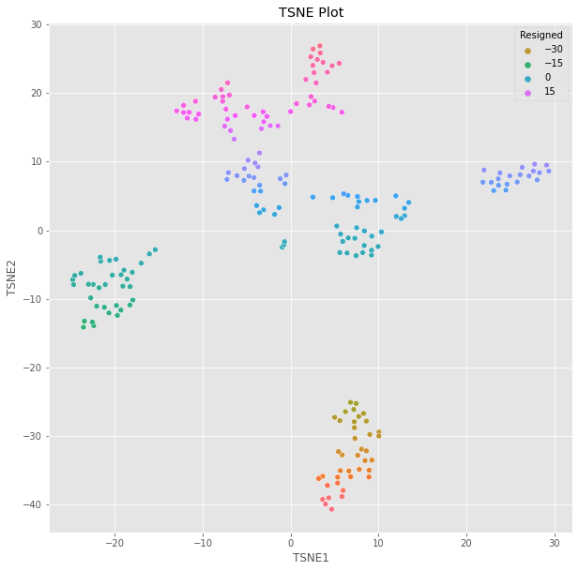
Dimensionality reduction (with gover distance)
T-distributed Stochastic Neighbor Embedding(t-SNE) probability distribution for the high-dimensional samples in such a way that similar samples have a high likelihood of being picked while dissimilar points have an extremely small likelihood of being picked Setting the learning rate to auto
ISOMAP Create a neighborhood network at the start Uses graph distance to the approximate geodesic distance between all pairs of points
Overall, tsne was used due to clear clusters

Slide 16
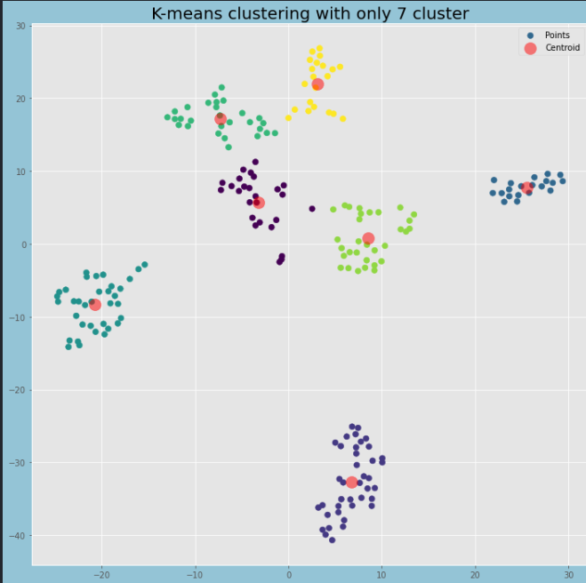
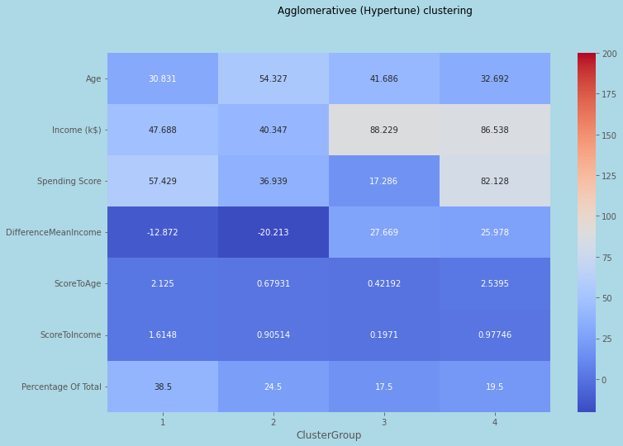
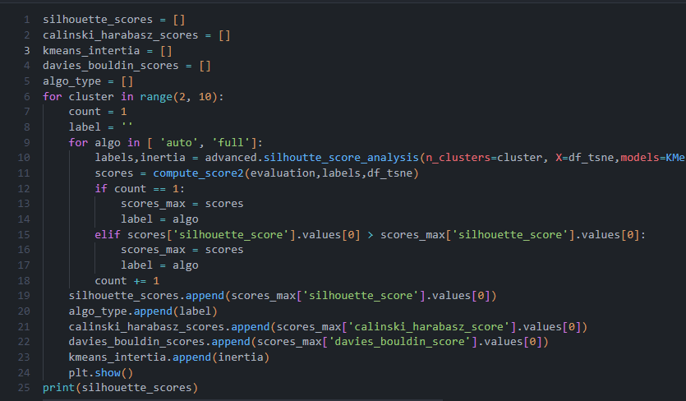
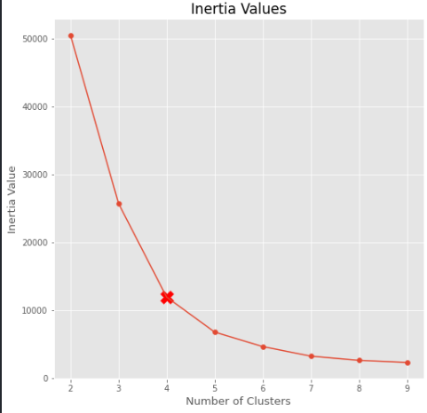
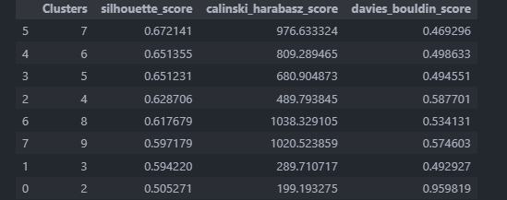
HYpertuning (model improvement)
K Means Clustering Tuning of n clusters and algorithm was done While 4 is shown in elbow plot, it was not necessary the best hence We observe that cluster 7 and 6 are the best result according to all 3 metric
From KMeans Plot, we can see that the clusters are nicely separated with similar data points seen in the different clusters

Slide 17
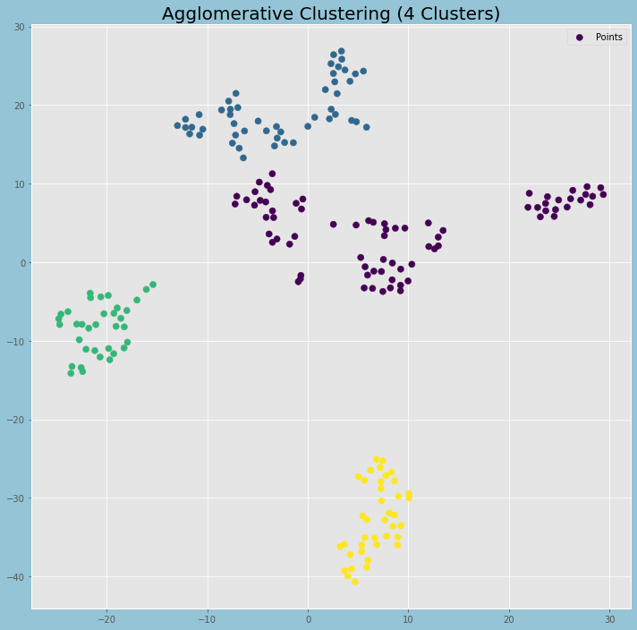
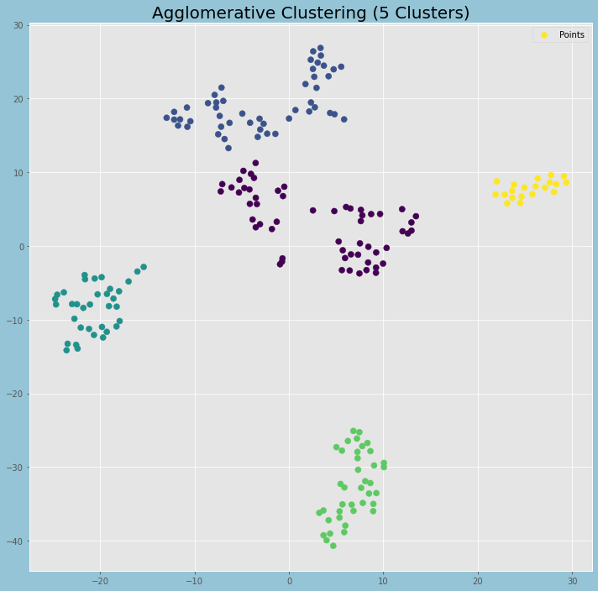
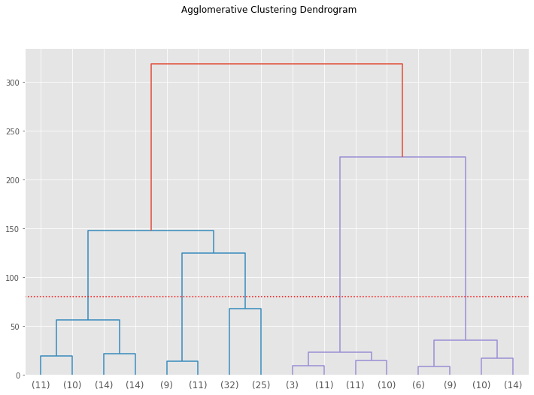
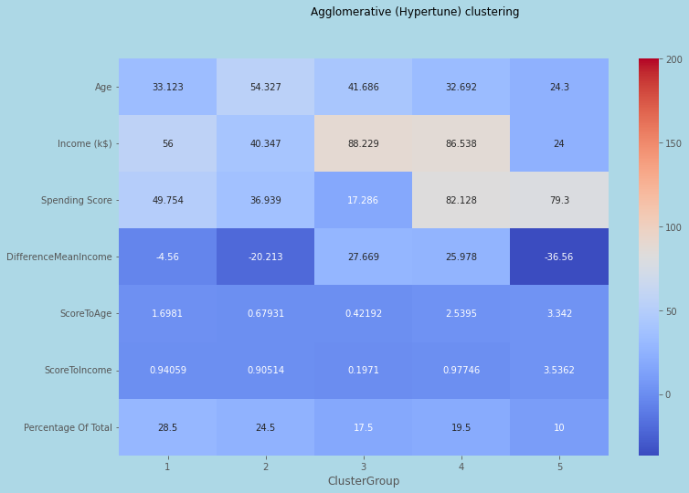
HYpertuning (model improvement)
Agglomerative Clustering Tuning of n clusters and algorithm was done Using dendrogram, we have 2 separate models one with 4 clusters one with 5 Cluster 5 was the better model

Slide 18
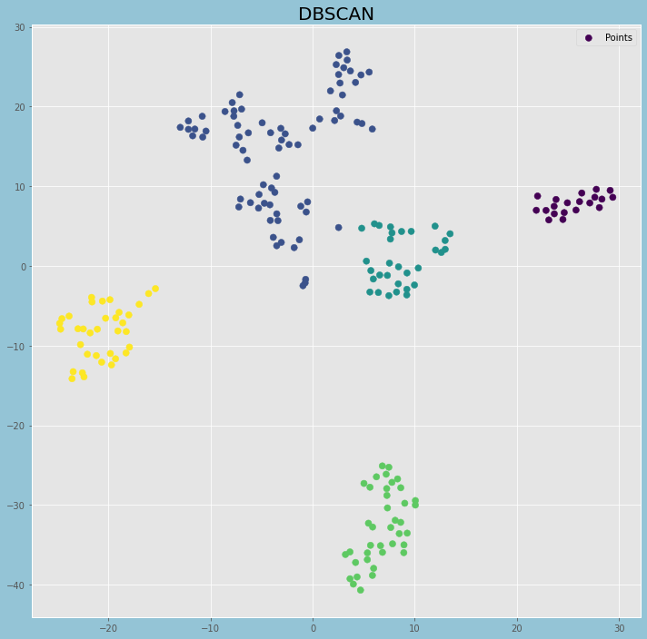
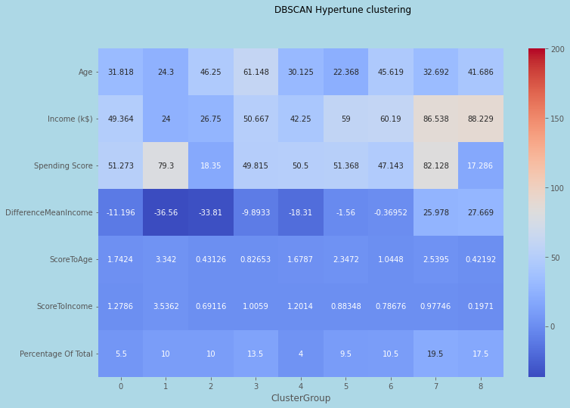
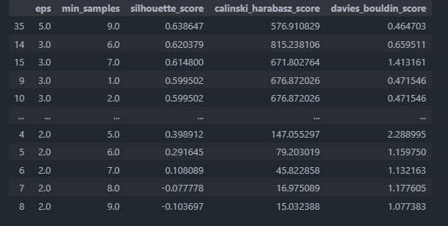
HYpertuning (model improvement)
DBSCAN Tuning of epsilon and min samples in parameters was done We notice that eps with 5 and min samples 9 has the best result
All the clusters are perfectly separated

Slide 19
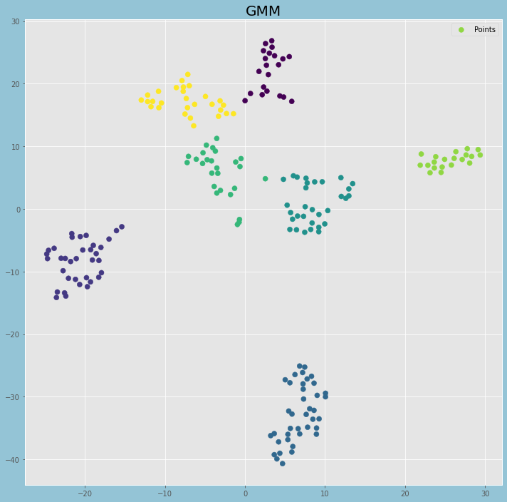
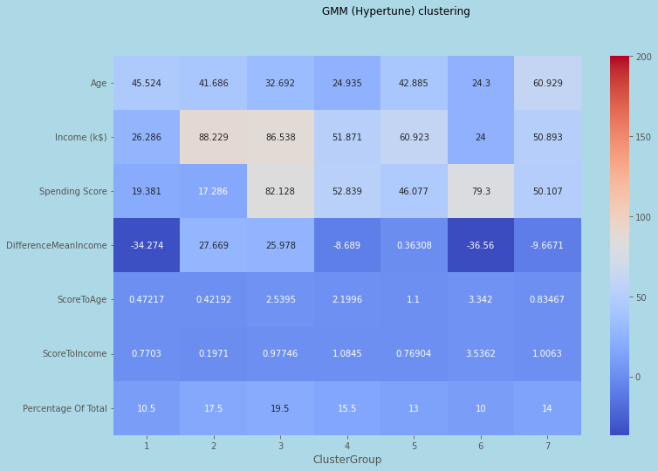
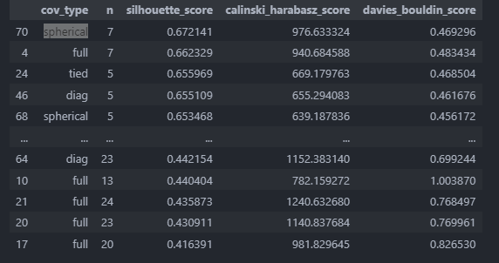
HYpertuning (model improvement)
GMM Tuning of covariance type and n components was done From the result set, spherical and n components as 7 has produced the best result
From GMM Plot, we can see that the clusters are nicely separated with similar data points seen in the different clusters

Slide 20
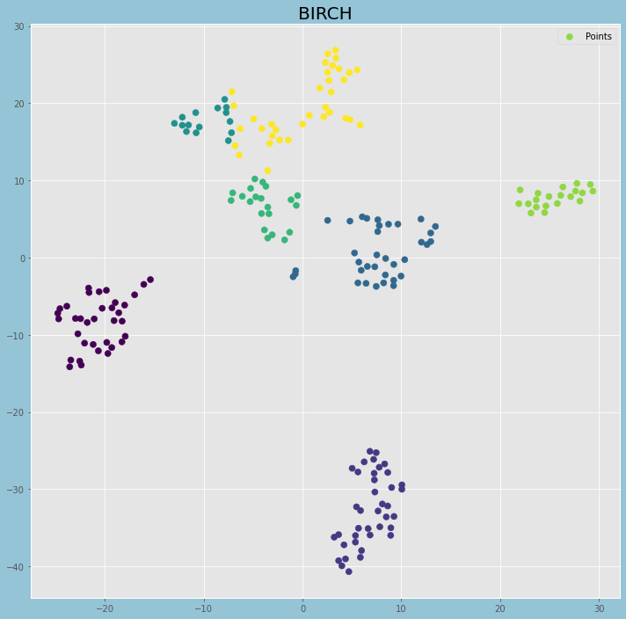


HYpertuning (model improvement)
BIRCH Tuning of n clusters and threshold and branching factor was done We can see that the number of n_clusters that provides the best scores are 7, threshold is 7 and branding factor is 20
From BIRCH Plot, we can see that the clusters are nicely separated with similar data points seen in the different clusters

Slide 21




Comparison (model improvement)
K Means and GMM was selected to be the final 2 models
With combinatorics, the overall scores was better for k means and hence combinatorics was used for k means but not for GMM
Kmeans , GMM

Slide 22



FInal model
K Means Final model is k means with 7 clusters Scores are 0.67214 976.633324 0.469296 respectively Cluster 1: High Income middle age Customers (Save Type Cluster 2: Young adults who just come out from university and have not found job<br/> Cluster 3: Young working adults who has work for quite some time Cluster 4: Old People with moderate income and likely close to retirement Cluster 5: Middle Age adults with moderate income Cluster 6: Young adults who has moderate income Cluster 7: Middle Age adults who are low income

Slide 23
COnclusion and recommendation
What can the shopping malls do ?
From our clusters, we notice that there are two key groups known as `middle age` and `young adults` but contains the following differences
- They have different income
- They have different spending score
Therefore, what can we do?
- Shopping malls can provide monthly offers
- Shopping malls can have tiered membership to enable those of a lower income to enjoy more benefits
- Shopping malls can integrate online stores into their ecosystem as more people are shopping online
Overall, shopping mall could consider more advertisement on social media or bigger sales event

